Slide 1
Life Cycle Cost Methods, Project Financing Options

Slide 2
The Life Cycle Cost (LCC) method is a comprehensive approach to evaluating the total cost of ownership of an asset, system, or project over its entire lifespan. It considers all costs associated with acquiring, operating, maintaining, and disposing of the asset.
Life Cycle Cost Components:
Initial Investment Costs: Purchase price, installation, and commissioning.
Operating Costs: Energy, fuel, labour, and maintenance.
Maintenance and Repair Costs: Scheduled and unscheduled maintenance.
Replacement Costs: Cost of replacing parts or the entire asset.
Salvage Value: Residual value at the end of the asset's life.
Disposal Costs: Cost of disposing of the asset at the end of its life.

Slide 3
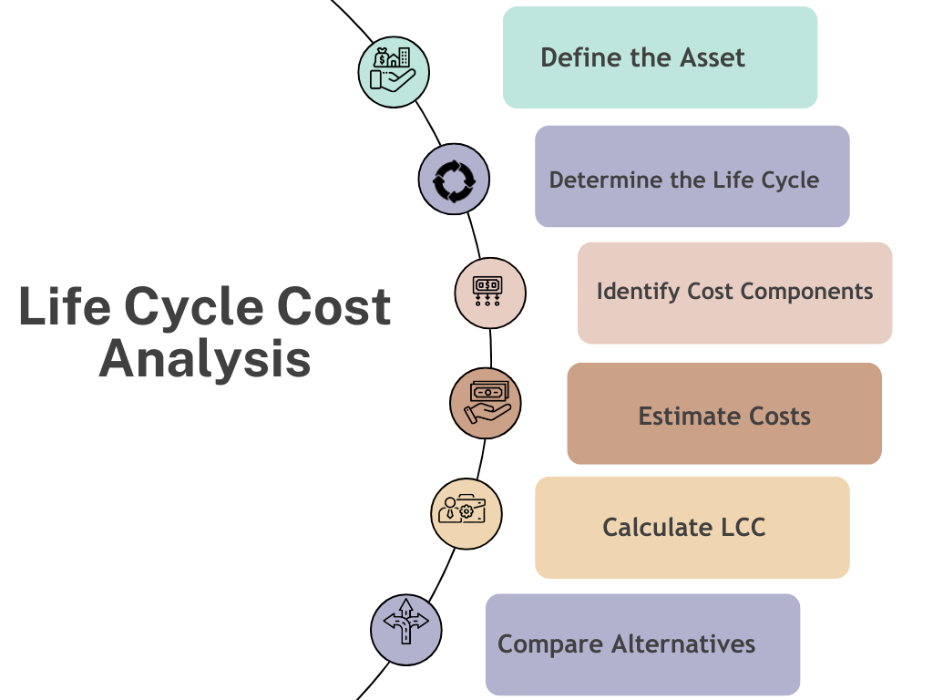

Slide 4
Example:
Suppose you're evaluating two air conditioning systems:
System A:
Initial cost: ₹1,00,000
Operating cost: ₹30,000/year
Maintenance cost: ₹10,000/year
Lifespan: 10 years
System B:
Initial cost: ₹1,50,000
Operating cost: ₹20,000/year
Maintenance cost: ₹5,000/year
Lifespan: 15 years
LCC Calculation:
System A: ₹1,00,000 + (₹30,000 x 10) + (₹10,000 x 10) = ₹4,00,000 System B: ₹1,50,000 + (₹20,000 x 15) + (₹5,000 x 15) = ₹4,25,000
Conclusion:
Although System B has a higher initial cost, its lower operating and maintenance costs result in a similar LCC. Consider factors like energy efficiency, reliability, and performance when making a decision.

Slide 5
Benefits of LCC Analysis:
Informed Decision-Making: Consider all costs.
Cost Reduction: Identify areas for cost savings.
Optimized Asset Management: Plan maintenance and replacement.
Improved Budgeting: Accurate cost forecasting.
Limitations:
Estimation Uncertainty: Difficulty predicting future costs.
Discount Rate: Sensitivity to discount rate assumptions.
Inflation: Impact of inflation on costs.

Slide 6
To calculate the Life Cycle Cost (LCC) of a software, we need to account for all costs involved throughout its life span. These typically include:
1. Initial Development Costs (IDC) : Costs incurred to design, develop, and implement the software.
2. Operation and Maintenance Costs (O&M) : Recurring costs of running the software, including bug fixes, support, and updates.
3. Training Costs (T) : Costs for training employees to use the software.
4. Hardware Costs (H) : Costs of hardware required to run the software.
5. Disposal Costs (D) : Costs to retire or dispose of the software at the end of its useful life.
The formula to calculate Life Cycle Cost (LCC) is:
LCC = IDC + O&M + T + H + D
Example:
Let’s calculate the life cycle cost for a software with the following data:
- Initial Development Costs (IDC) = $200,000
- Operation and Maintenance Costs (O&M) = $30,000 per year for 5 years
- Training Costs (T) = $10,000
- Hardware Costs (H) = $50,000
- Disposal Costs (D) = $5,000

Slide 7
Solution:
1. IDC: $200,000
2. O&M: $30,000 per year for 5 years = $30,000 × 5 = $150,000
3. T: $10,000
4. H = $50,000
5. D = $5,000
Now, applying the formula:
LCC = IDC + O&M + T + H + D
LCC = 200,000 + 150,000 + 10,000 + 50,000 + 5,000
LCC = $ 415,000
Final Life Cycle Cost:
The total Life Cycle Cost (LCC) of the software is $415,000.
This is a simplified model, but in practice, you could also account for discount rates if considering the time value of money.

Slide 8
Methods of Financing and Valuation
An Overview

Slide 9
Introduction
In this presentation, we will explore the various methods of financing available to businesses and investors, as well as the techniques used for valuation of assets and companies.

Slide 10
Methods of Financing
1. Debt Financing
2. Equity Financing
3. Hybrid Financing
4. Venture Capital
5. Leasing

Slide 11
Debt Financing
Borrowing funds from a lender.
Involves paying interest over a period of time.
Examples include bank loans and bonds.

Slide 12
Equity Financing
Raising capital by selling shares of the company.
Investors gain ownership stake in the business.
No repayment required, but owners share profits.

Slide 13
Hybrid Financing
Combination of debt and equity financing.
Examples include convertible bonds and preferred stocks.
Provides flexibility for companies in managing capital.

Slide 14
Venture Capital
A form of private equity investment.
Provided by investors to startups and small businesses.
High risk, but potential for high returns.

Slide 15
Leasing
Allows businesses to use assets without buying them.
Common for equipment and real estate.
Flexible financing option with lower initial costs.

Slide 16
Valuation Methods
1. Discounted Cash Flow (DCF)
2. Comparable Company Analysis (CCA)
3. Precedent Transactions
4. Asset-Based Valuation
5. Market Capitalization

Slide 17
Discounted Cash Flow (DCF)
Estimates the value of an investment based on its future cash flows.
Cash flows are discounted back to present value using a discount rate.
Commonly used for business and real estate valuation.

Slide 18
Comparable Company Analysis (CCA)
Values a company by comparing it to similar businesses in the same industry.
Looks at financial metrics like P/E ratio, revenue, and EBITDA.
Useful for benchmarking and determining relative value.

Slide 19
Precedent Transactions
Analyzes previous transactions in the same sector.
Looks at acquisition prices of comparable companies.
Provides insight into market trends and transaction premiums.

Slide 20
Asset-Based Valuation
Determines a company's value based on the value of its assets.
Net Asset Value (NAV) = Total Assets - Liabilities.
Useful for valuing companies with significant tangible assets.

Slide 21
Market Capitalization
Calculates the value of a publicly traded company.
Market Cap = Share Price × Number of Outstanding Shares.
Provides a quick estimate of a company's total value.

Slide 22
Conclusion
In conclusion, businesses have multiple options for financing, each with its benefits and risks. Valuation methods provide various approaches to determining the worth of a company or asset, aiding in informed financial decisions.

